Slide 1
MARCH
CRC AWARENESS MONTH
Social Media Toolkit
M-US-CG-05752

Slide 2
How to use the toolkit
Each copy and post can be used on social platforms such as LinkedIn, Facebook, and Instagram to promote CRC Awareness
Social media copy can be used interchangeably with any social media post
Social media copy can be modified only within the <pink brackets> with Health System/clinic specific information
To save the images, right-click on the desired image and select “Save as Picture.”

Slide 3
Social Media Posts: Recommended Copy (1/2)
Entities using this material are responsible for and should pay close attention to the accuracy of the information about their company and the coverage details that they distribute via these materials or otherwise. This template is provided to any appropriately requesting entity, regardless of the manner in which they cover, recommend, or participate in the ordering of Cologuard. You may adapt the provided content to suit the needs of your organization. ​
March is Colorectal Cancer Awareness Month. What better time than now to #PreventColonCancer? Talk with your <Health System name> provider about colon cancer screening and make a plan to get screened.
The reasons to screen for colon cancer are endless. March is #ColorectalCancerAwarenessMonth and is an especially great time to think about your why and get it done. Get started at <link to patient portal> or by calling our office at <phone number>.
Make March matter – get screened for colon cancer as soon as you’re eligible. #PreventColonCancer
Make March matter – if you’re 45 or older, you’re eligible to get screened for colon cancer. #PreventColonCancer.
Getting screened when you’re eligible is one thing you can do that will make a difference long after #ColorectalCancerAwarenessMonth ends. Ready to get started? Call our office at <phone number> or visit our patient portal at <link to patient portal> to make an appointment today.

Slide 4
Social Media Posts: Recommended Copy (2/2)
Entities using this material are responsible for and should pay close attention to the accuracy of the information about their company and the coverage details that they distribute via these materials or otherwise. This template is provided to any appropriately requesting entity, regardless of the manner in which they cover, recommend, or participate in the ordering of Cologuard. You may adapt the provided content to suit the needs of your organization. ​
It’s #ColorectalCancerAwarenessMonth. If you’re 45 or older, you’re eligible to get screened for colon cancer. Ready to get started? Call our office at <phone number> or visit our patient portal at <link to patient portal> to make an appointment today.
We recognize those who have screened for colon cancer, especially this #ColorectalCancerAwarenessMonth. If you needed a sign to get it done, let this be it. Get started today – call our office at <phone number> or visit our patient portal at <link to patient portal> to make an appointment.
Early detection of precancer and early-stage colorectal cancer is key to prevention and better outcomes. #PreventColonCancer this March. Get started at <link to patient portal> or by calling our office at <phone number>.

Slide 5


Slide 6


Slide 7
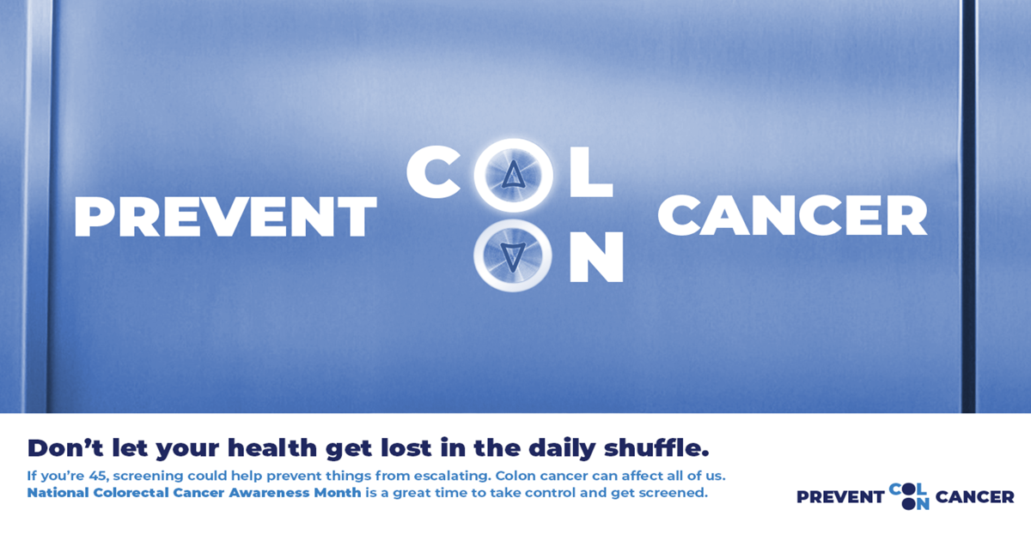

Slide 9


Slide 10
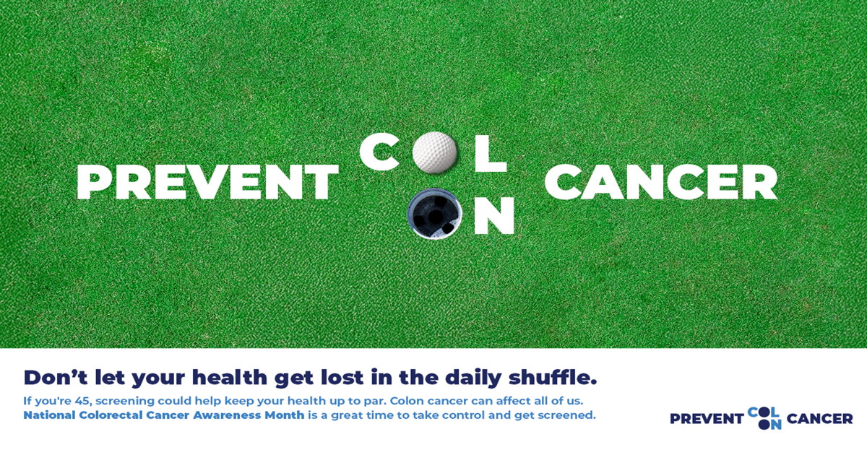

Slide 12


Slide 13
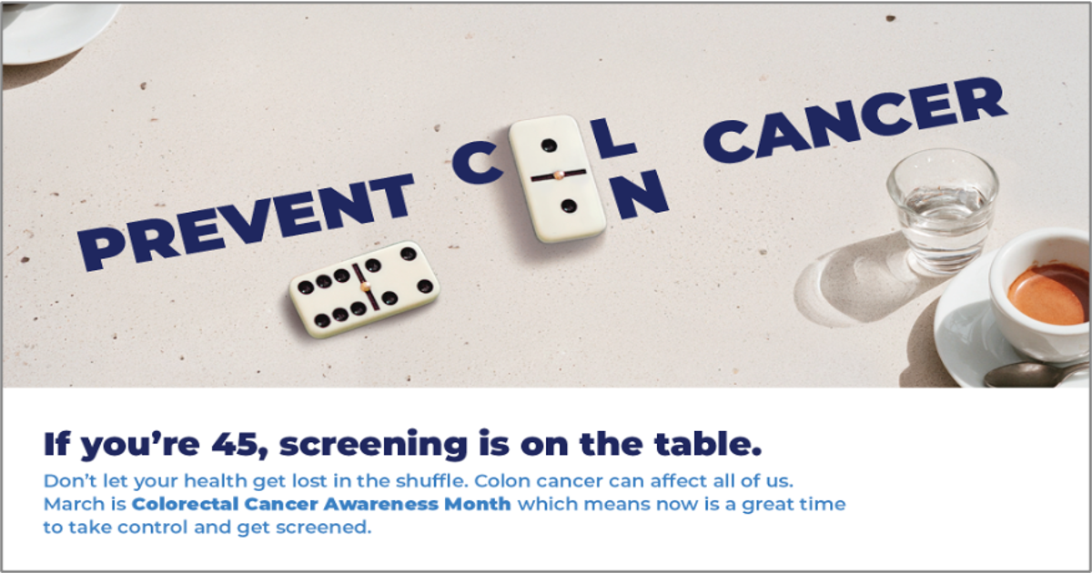

Slide 14


Slide 15


Slide 16


Slide 17
